Slide 1
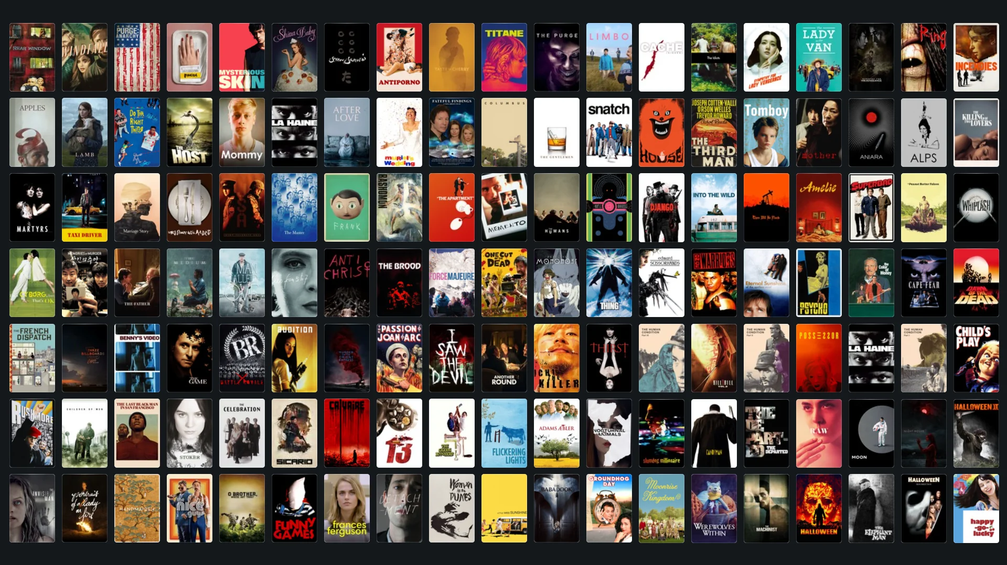
Analysis of the Movie Industry
By Tom Parkinson

Slide 2
About the dataset
TMDB 5000 Movies Dataset – Kaggle (https://www.kaggle.com/datasets/tmdb/tmdb-movie-metadata)
Data taken from film database TMDB
Dataset is 7 years old

Slide 3

Genres

Slide 4
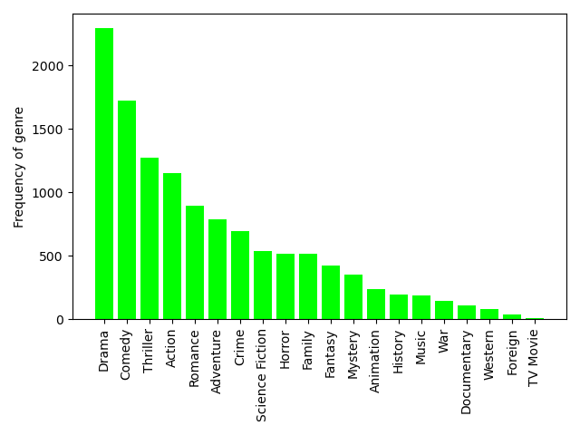
Frequency of genres

Slide 5
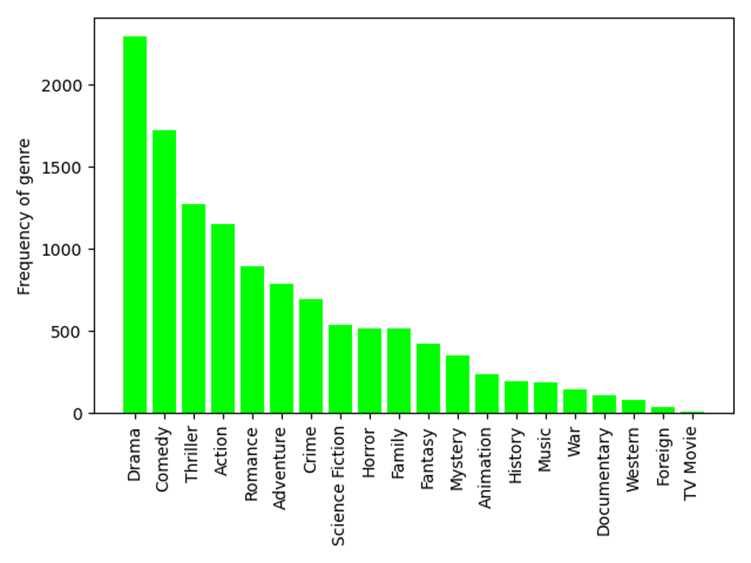
Frequency of genres
Most common genres are drama, comedy and thriller.
Least common genres are foreign and TV movie, likely due to TMDB users being mainly English speaking.

Slide 6
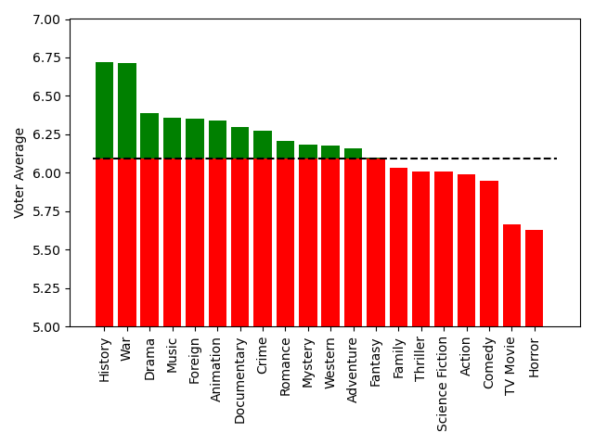
Average voter rating of genres

Slide 7


Average voter rating of genres
Highest rating goes to more serious genres (history, war, documentary)
Surprisingly, horror movies are rated below TV movies.

Slide 8
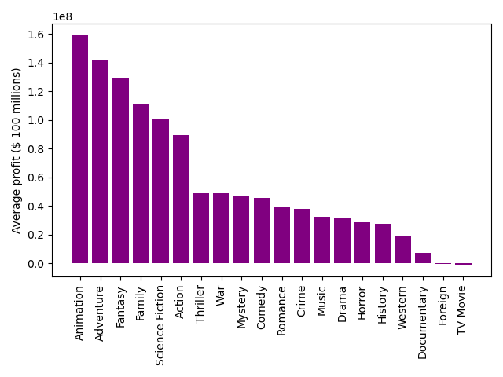
Profitability of genres

Slide 9
Profitability of genres
Foreign and TV movies on average lose money, even in top 5000.
Animated films make most money, likely due to high accessibility and not requiring big name actors to be successful.
Animated films also usually have large budget and big studio backing (indie animated films are rare).

Slide 10
Profitability vs Frequency of genres
Similar, but genres like fantasy and animation are under-exploited. The lower end is almost identical.

Slide 11
Runtime

Slide 12
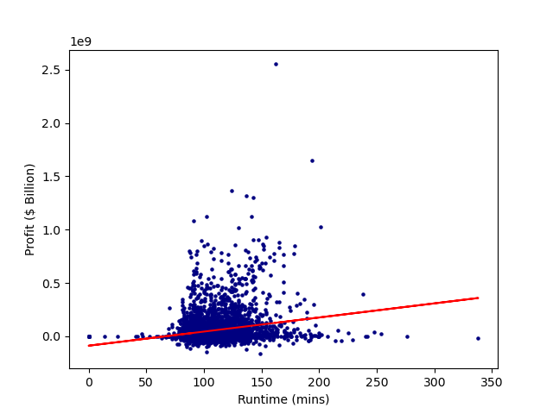
Runtime vs. Profit

Slide 13
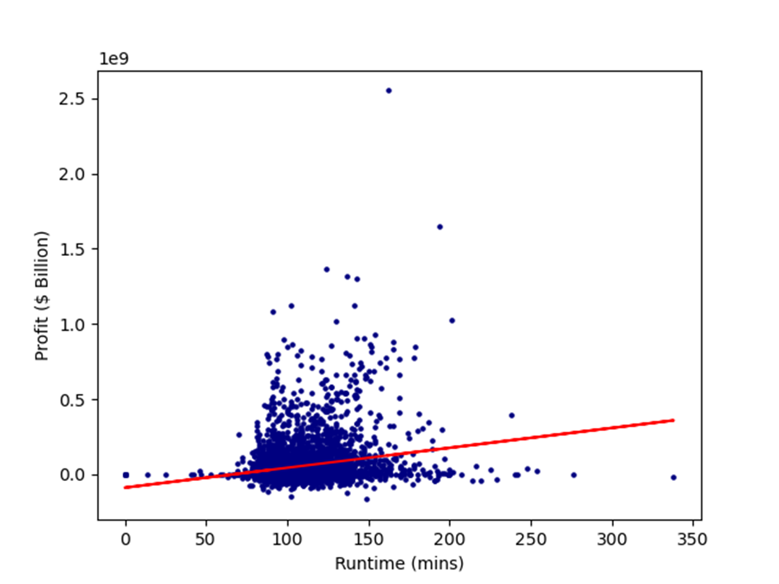
Runtime vs. Profit
Longest film is Gettysburg (1993) at 4h 19m.
Most profitable film is Avatar (2009) at $2.55 billion.

Slide 14
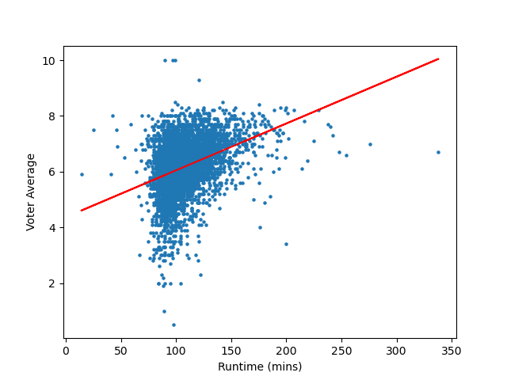
Runtime vs. Voter Average

Slide 15
Runtime vs. Voter Average
Highest rating with more than 5 votes is The Shawshank Redemption (1994) with 8.5 rating.

Slide 16
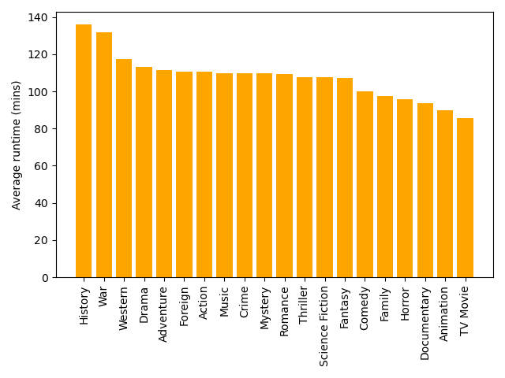
Runtime of genres

Slide 17
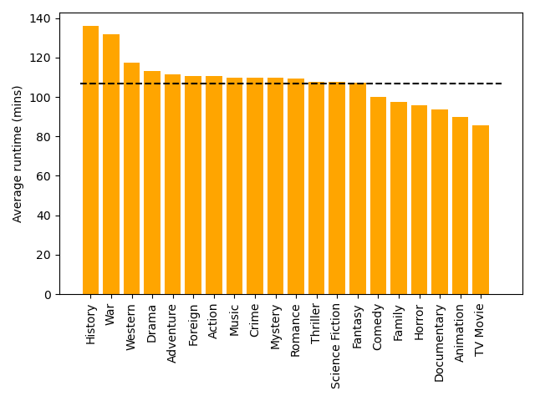
Runtime of Genres

Slide 18


Conclusions
Perfect film would be a 3-hour long war musical.
Les Misérables
Biggest gap in market is fantasy and animated movies.
The Minecraft movie will be the highest grossing film of all time.

Slide 19
Thank you for listening!

